Slide 1


Akshay Babasaheb More
28/10/2021

Slide 2
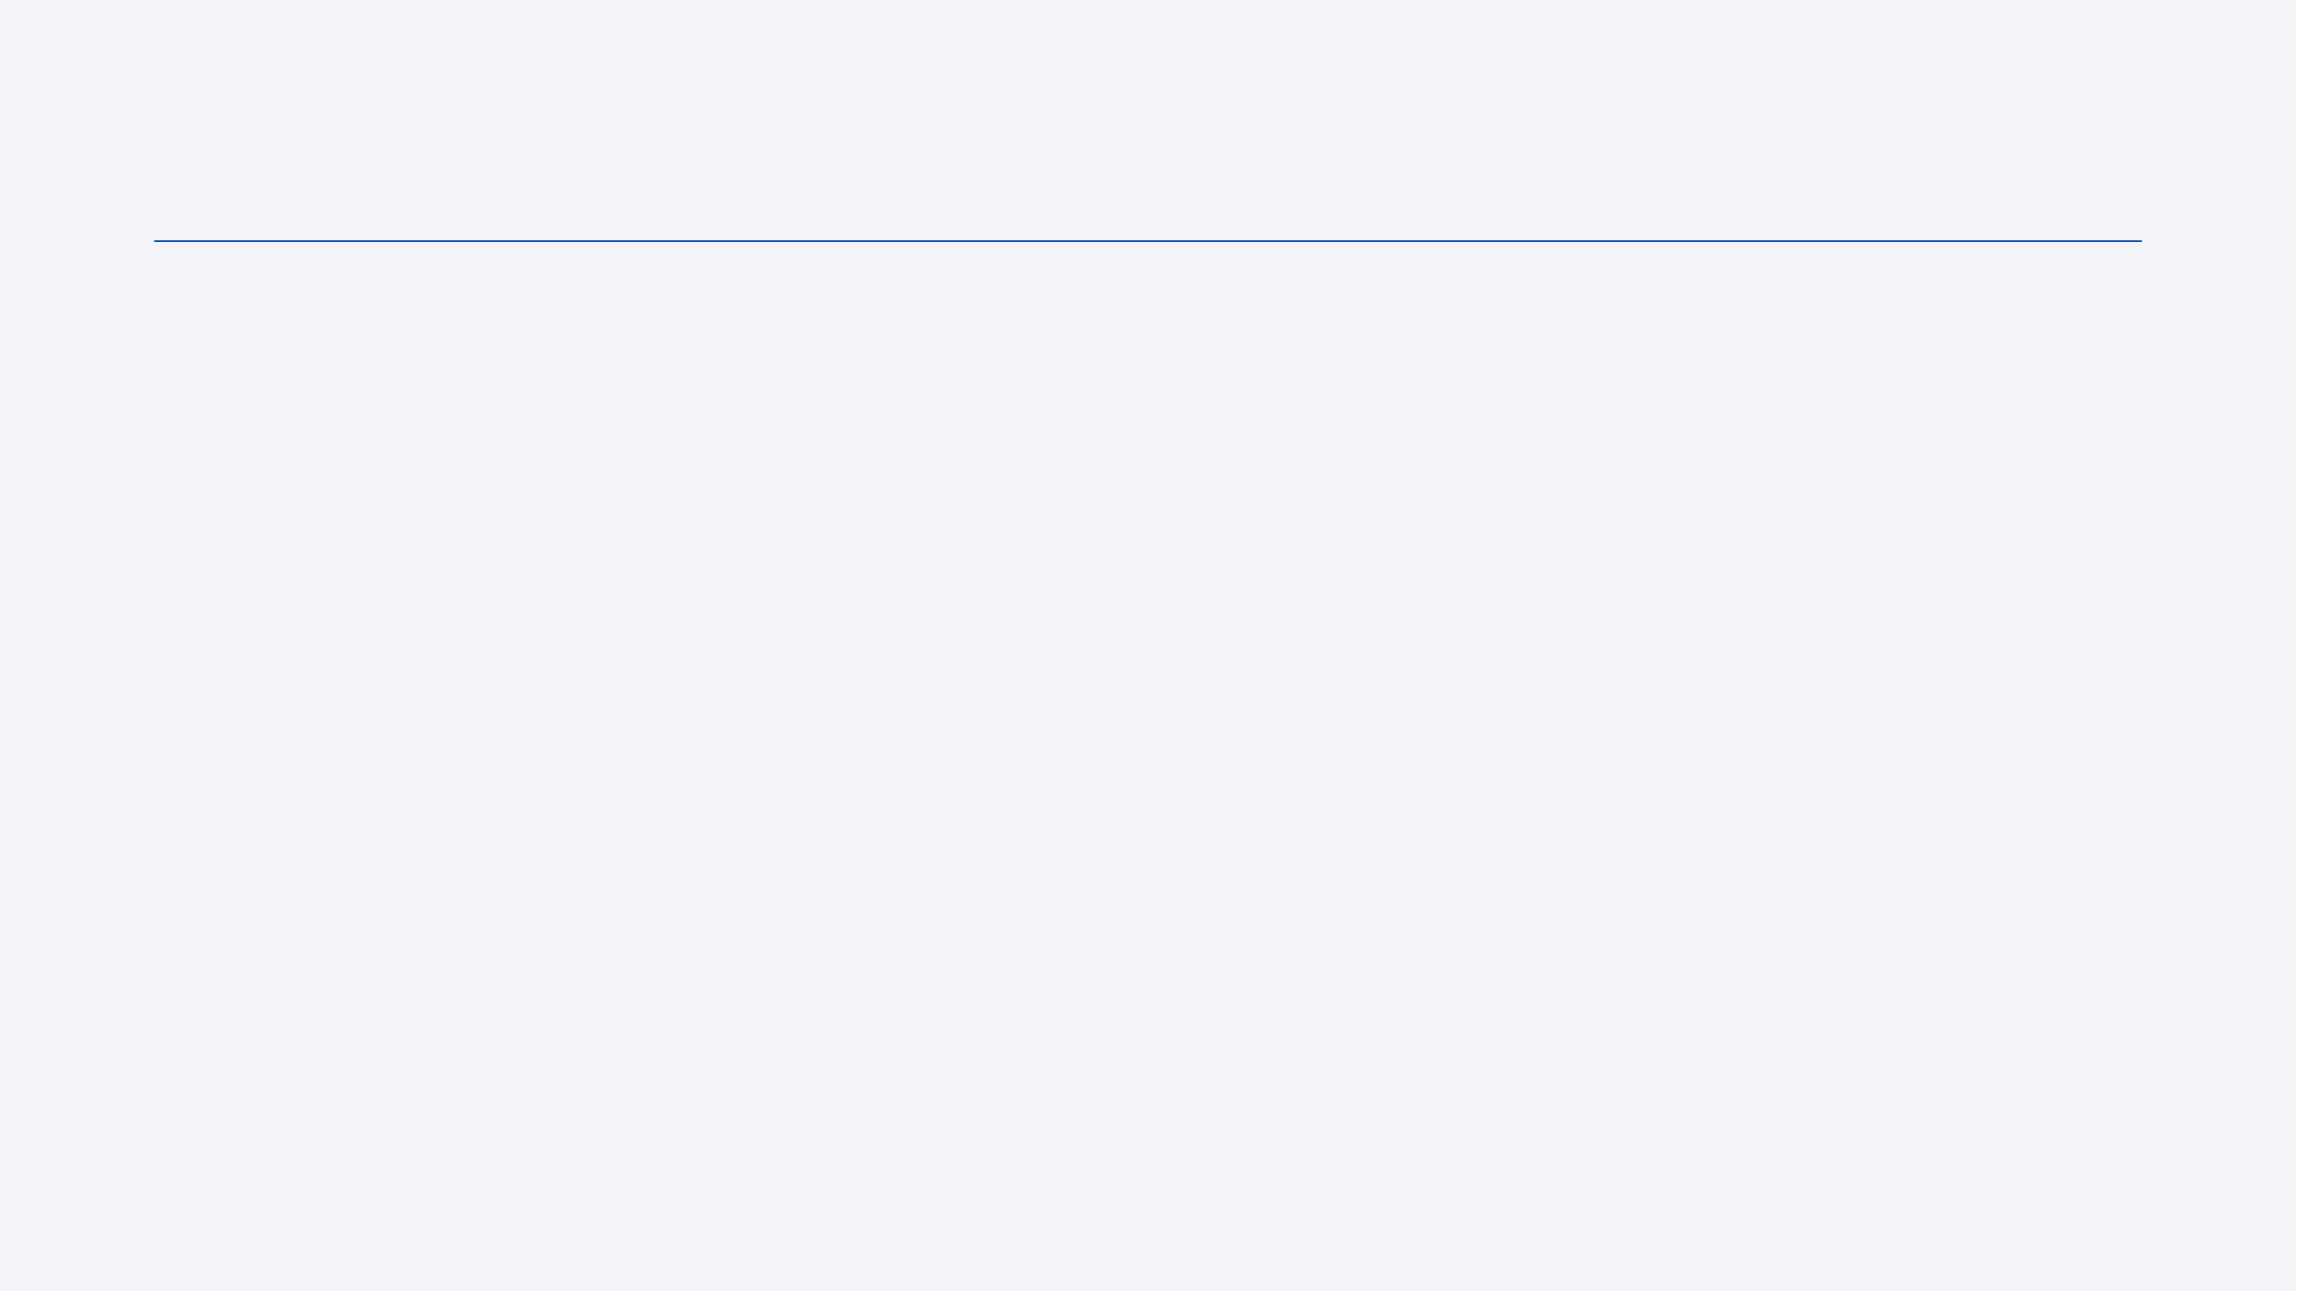
Introduction
SpaceX Falcon 9 first stage Landing Prediction
Request to the SpaceX API
Clean the requested data

Slide 3


Slide 4
Methodology
Executive Summary
Data collection methodology:
Qualitative Data Collection-Online Forum, Group Chat ,Web Survey Chat, Online Communication
Quantitative Data Collection- Face to Face, Phone ,Mail.
Perform data wrangling
Data Acquisition: Identify and obtain access to the data within your sources.
Joining Data: Combine the edited data for further use and analysis.
Data Cleansing: Redesign the data into a usable and functional format and correct/remove any bad data.
Performed exploratory data analysis (EDA) using visualization and SQL

Slide 5
Data Collection
def getBoosterVersion(data): for x in data['rocket’]:
response = requests.get("https://api.spacexdata.com/v4/rockets/"+(x)).json()
BoosterVersion.append(response['name'])
def getPayloadData(data):
for load in data['payloads’]:
response = requests.get("https://api.spacexdata.com/v4/payloads/"+load).json()
PayloadMass.append(response['mass_kg’])
Orbit.append(response['orbit'])

Slide 6
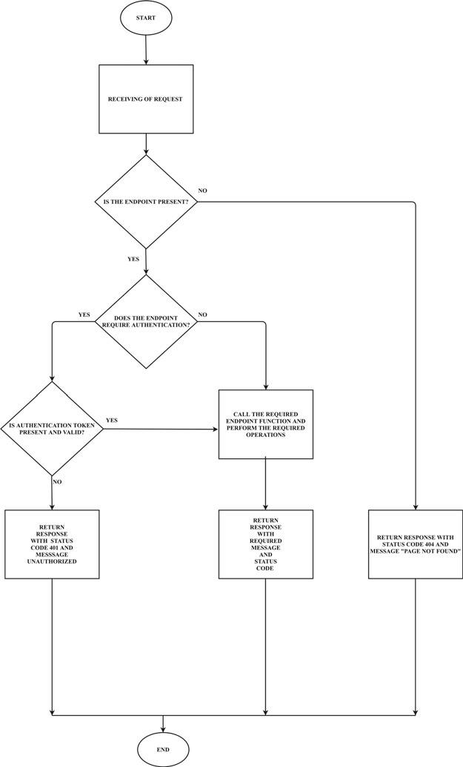
Data Collection – SpaceX API
SpaceX REST calls using key phrases and flowcharts
https://github.com/Akshaymore55/Applied-Data-Science/blob/master/Jupyter-labs-SpaceX-data-collection-API.ipynb
Place your flowchart of SpaceX API calls here

Slide 7
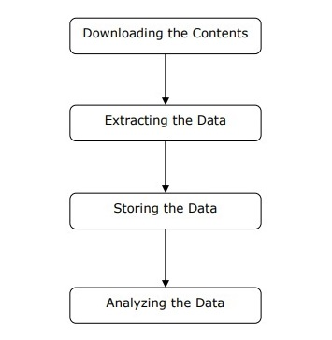
Data Collection - Scraping
Present your web scraping process using key phrases and flowcharts
Place your flowchart of web scraping here

Slide 8
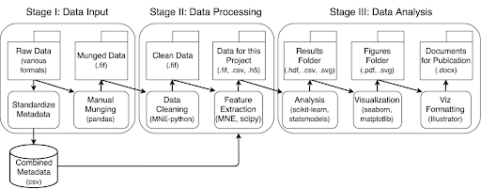
Data Wrangling
Data wrangling is the process of cleaning and unifying messy and complex data sets for easy access and analysis.

Slide 9
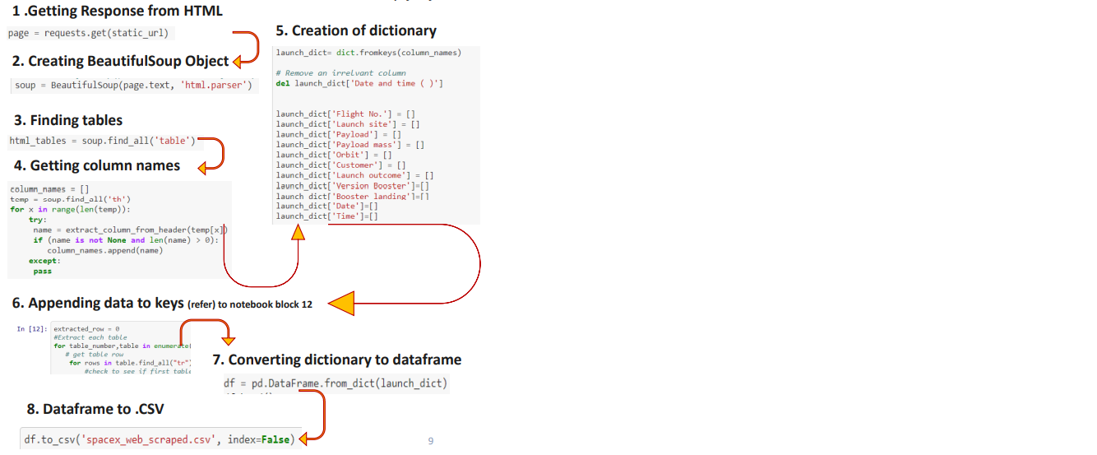
Data Collection with API:-

Slide 10
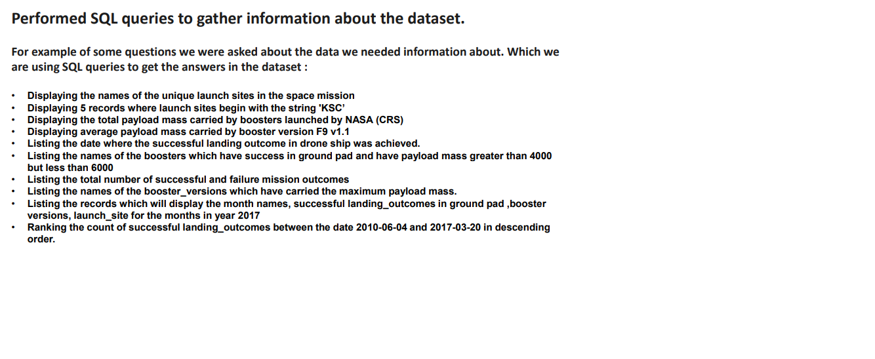
EDA SQL Describe:-

Slide 11
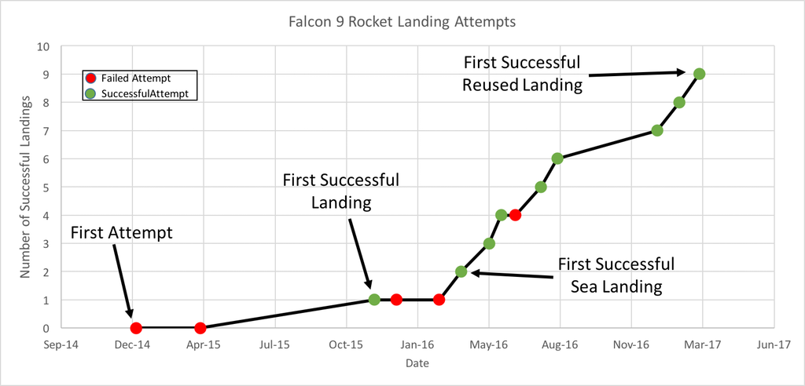
EDA with Data Visualization

Slide 12
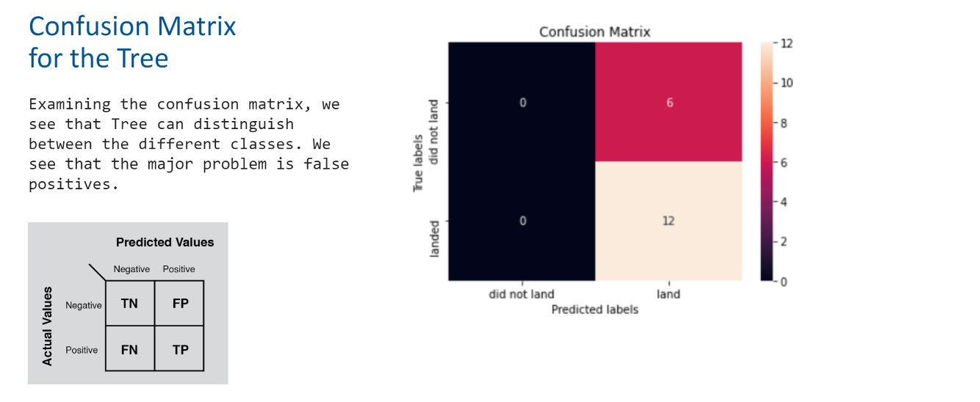
Build an Interactive Map with Folium
Summarize what map objects such as markers, circles, lines, etc. you created and added to a folium map
Explain why you added those objects
Add the GitHub URL of your completed interactive map with Folium map, as an external reference and peer-review purpose

Slide 13
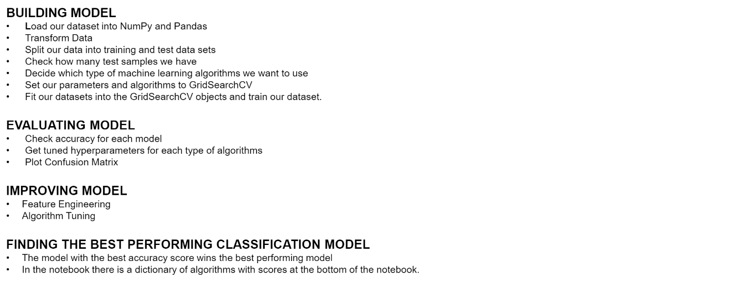
Predictive Analysis (Classification)
Summarize how you built, evaluated, improved, and found the best performing classification model
You need present your model development process using key phrases and flowchart
Add the GitHub URL of your completed predictive analysis lab, as an external reference and peer-review purpose

Slide 14


Slide 15
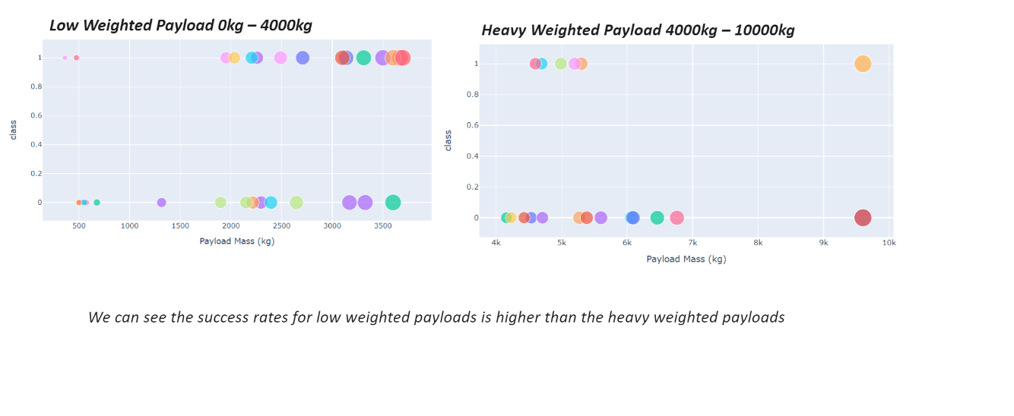
Low weighted payload vs Heavy payload
Show a scatter plot of Flight Number vs. Launch Site
Show the screenshot of the scatter plot with explanations

Slide 16


Slide 17
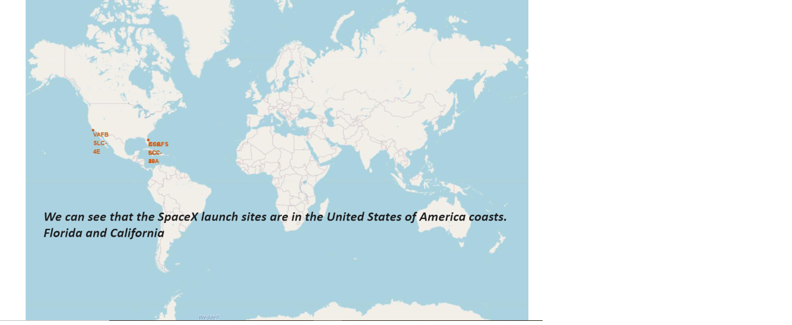
All Launch sites:-

Slide 18


Slide 19
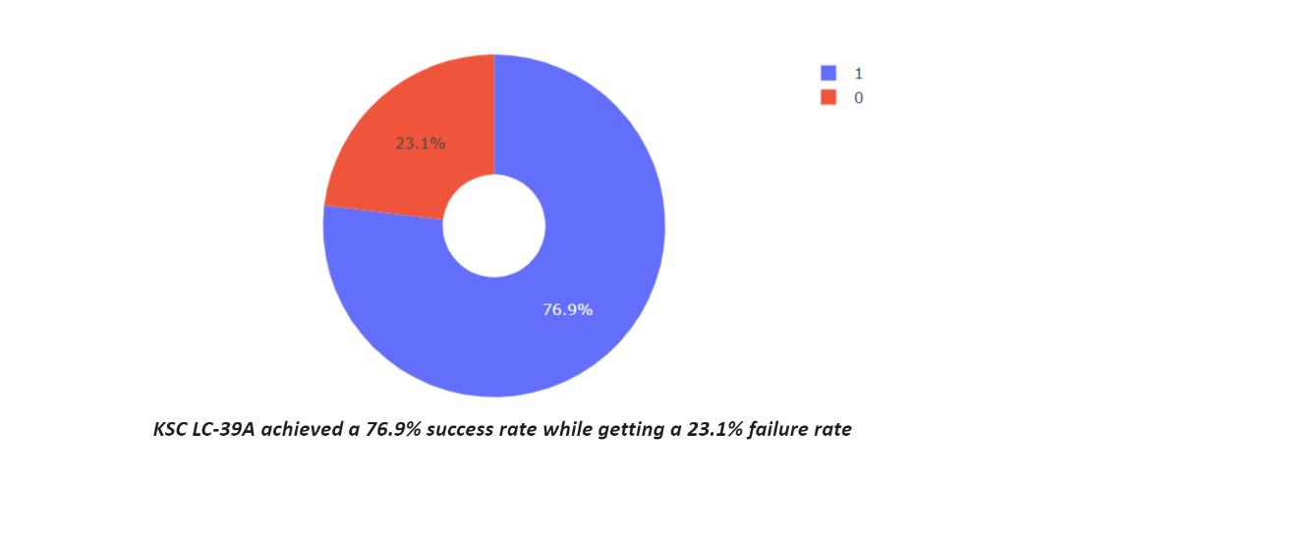
Total Success Launch Site:-

Slide 20
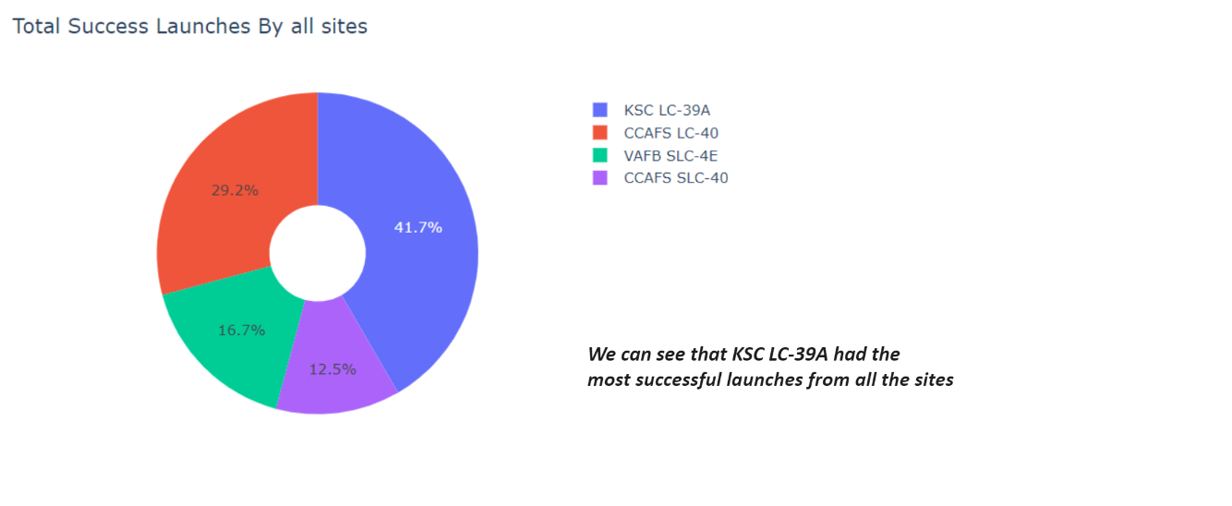
Highest Launch Site:-

Slide 21
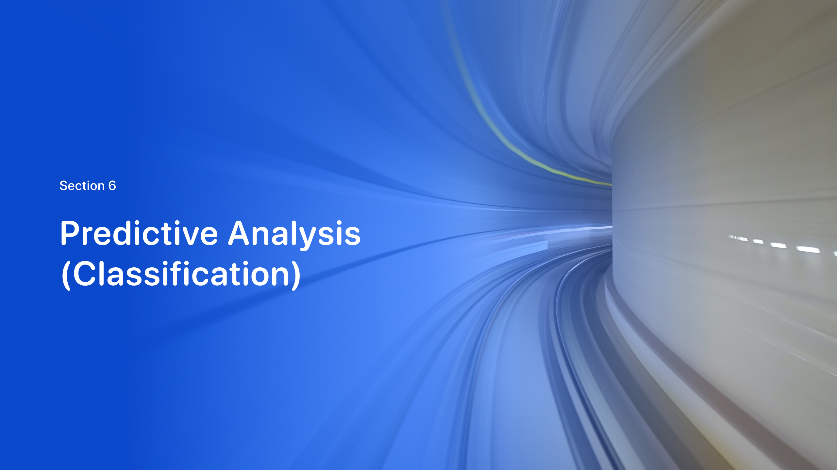

Slide 22
Predative Analysis:-

Slide 23
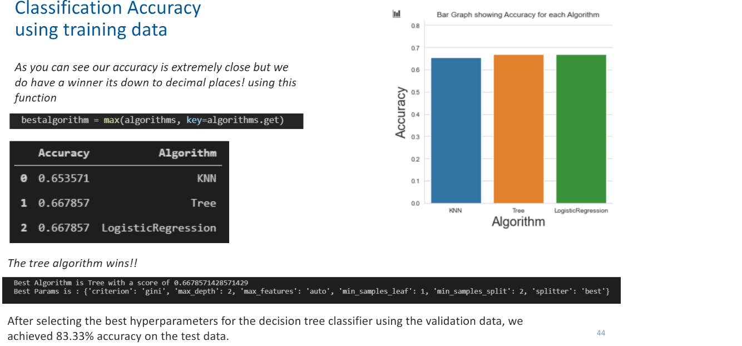

Slide 24


